Slide 1
Lab211- Spring 2021 P0004-Tutorial

Slide 2
Problem Analyze
All animal's information in the zoo is contained in file animals.txt. In the current stage, the zoo has 4 groups of animals as follows:
– Group of 0-legged animals- snake has the properties such as no leg, black and white color, can creep, poisonous, 10 kg (original: 3 kg).
– Group of bipedal and flightless animals- penguin has the properties such as two legs, two swings, cute, color, can walk, make sound, 6kg.
– Group of bipedal and flying animals: pigeon has the properties such as two legs, two swings, heroic, can fly, 1kg.
– Group of 4-legged animals: tiger has the properties such as 4 legs, can run, can growl (gầm gừ)), danger, eat raw meat, 300kg (original 100 kg).
Concepts: AnimalType, animal in generic, specific animal (ZLA, BFLA, BLA, FLA)
2 relationships: an animal belongs to a type
a 0-legged animal is an animal

Slide 3
Design: the AnimalType class
– Group of 0-legged animals (ZLA)- snake has the properties such as no leg, black and white color, can creep, poisonous, 10 kg.
– Group of bipedal and flightless animals (BFLA)- penguin has the properties such as two legs, two swings, cute, color, can walk, make sound, 6kg.
– Group of bipedal and flying animals (BFA): pigeon has the properties such as two legs, two swings, heroic, can fly, 1kg.
– Group of 4-legged animals (FLA): tiger has the properties such as as 4 legs, can run, can growl (gầm gừ), danger, eat raw meat, 100kg.
AnimalType class
int type
String desc
int numLegs
int numSwings
String movingMethod
boolean canFly
boolean canSing
boolean canGrowl
String food
double maxWeight
Pick out the most common properties for presenting an animal type.

Slide 4
Class Design: Classes for Animals
Pick out the common properties for presenting an animal.
ZLA class
Boolean poisonous
AnimalType class
int type
String desc
int numLegs
int numSwings
String movingMethod
boolean canFly
boolean canSing
boolean canGrowl
String food
double maxWeight
Pick out the private properties for a specific animal
Animal class
String ID
String name
AnimalType type
String color
Double weight
BFLA class
Boolean cute
BFA class
Boolean heroic
FLA class
Boolean canGrowl
Boolean danger
The “belonging to” relationship is implemented using a reference.
The “is-a” relationship is implemented using inheritance.

Slide 5
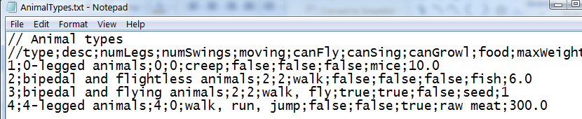
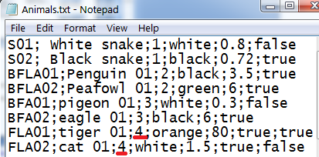
Design: Program’s Initial Data
Read-only data are available in file.
File 1: AnimalTypes.txt
A list of animal types (ArrayList)
File 2: Animals.txt
A list of animals (ArrayList)
Objects can be added/updated
Data in Father class
Extensions in subclass

Slide 6
Design: Program’s Initial Data
AnimalType class
int type
String desc
int numLegs
int numSwings
String movingMethod
boolean canFly
boolean canSing
boolean canGrowl
String food
double maxWeight
‘;’ is used to separate fields
File 1: AnimalTypes.txt
A list of animal types (ArrayList)

Slide 7
Design: Program’s Initial Data
ZLA class
Boolean poisonous
Animal class
String ID
String name
AnimalType type
String color
Double weight
BFLA class
Boolean cute
BFA class
Boolean heroic
FLA class
Boolean canGrowl
Boolean danger
File 2: Animals.txt
A list of animals (ArrayList)
‘;’ is used to separate fields

Slide 8
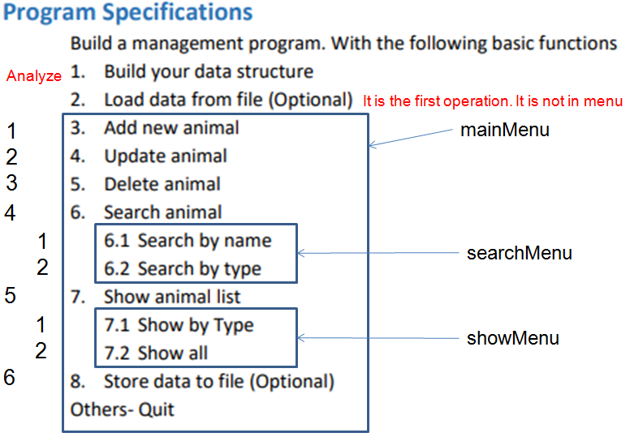
Class Design: Supporting classes: Menu
mainChoice
subChoice
Variables for user choices

Slide 9
Class Design: Supporting classes: MyScanner
AnimalType class
int type
String desc
int numLegs
int numSwings
String movingMethod
boolean canFly
boolean canSing
boolean canGrowl
String food
double maxWeight
ZLA class
Boolean poisonous
Animal class
String ID
String name
AnimalType type
String color
Double weight
BFLA class
Boolean cute
BFA class
Boolean heroic
Input string can not be blank
0 <weight<= maxWeight
Input a boolean value
➔ Class MyScanner
FLA class
Boolean canGrowl
Boolean danger
These data are available in file → No valiadator is needed

Slide 10
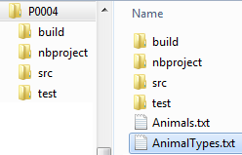
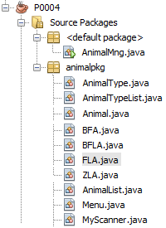
Design: Software Structure
Class | Present
AnimalMng | Program manages a list of animals
AnimalType | A type of animals
AnimalTypeList | A list of animal types
Animal | Basic class for an animal
ZLA extends Animal | Class for a 0-legged animal
BFLA extends Animal | Class for a bipedal-flightless animal
BFA extends Animal | Class for a bipedal-flying animal
FLA extends Animal | Class for a 4-legged animal
Menu | Class for a menu
MyScanner | Supporting class for input with validation

Slide 11
Design in Details & Implementations (DDI)

Slide 12
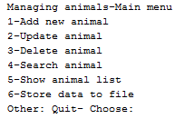



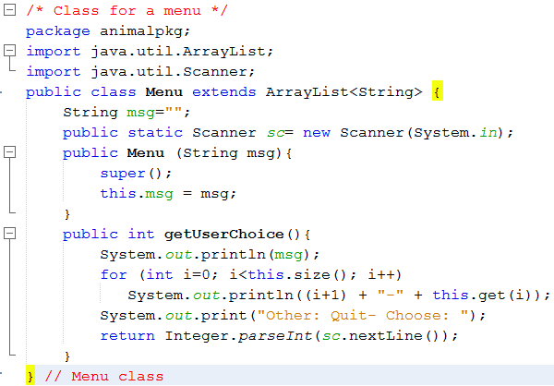
DDI: The Menu class

Slide 13

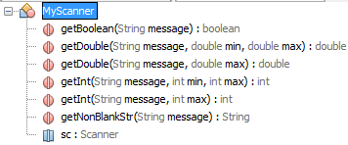




DDI: The MyScanner class
public static methods

Slide 14
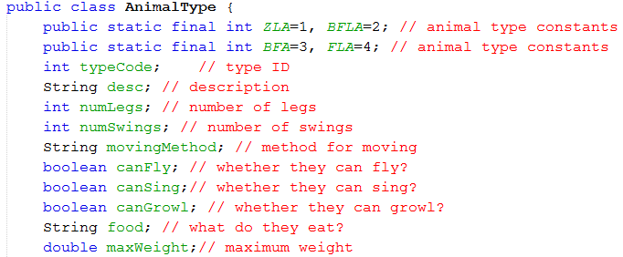
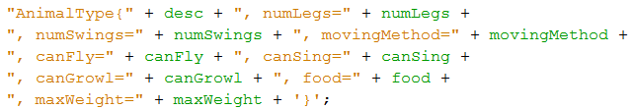
DDI: The AnimalType class
10-parameter constructor, getters, setters.
toString() method for printing to monitor. Use the following format:

Slide 15

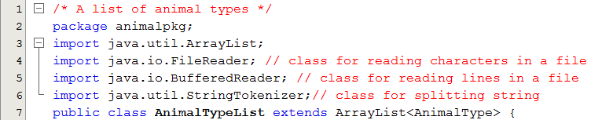
DDI: The AnimalTypeList class
This problem doesn’t manage animal types. So, only four methods are needed.
// Choosing a type using a menu when user inputs an animal
// Create a menu for choosing an animal type when user inputs an animal
// Loading animal types from a text file
// Search animal type using typeID- Using linear search

Slide 16
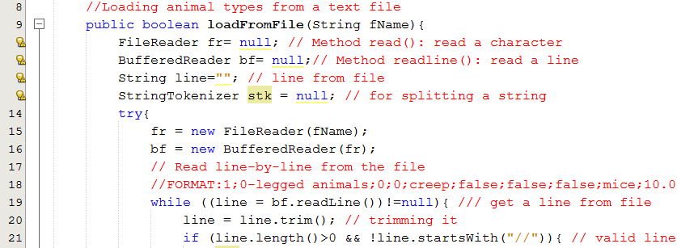
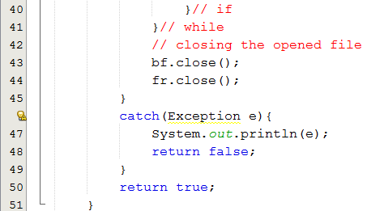
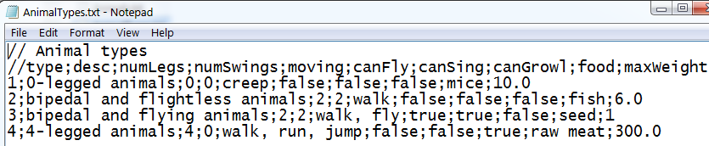
DDI: The AnimalTypeList class
Get properties, create a type, add the type to the list.

Slide 17
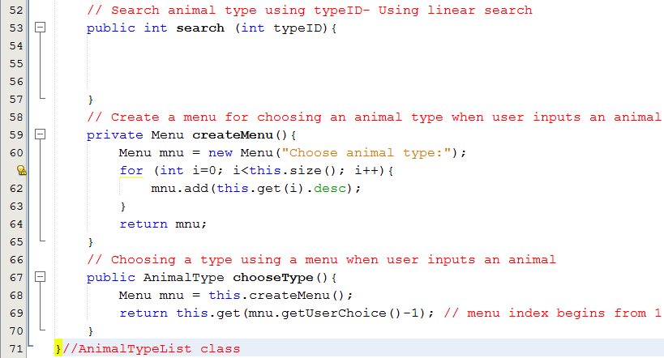
DDI: The AnimalTypeList class

Slide 18
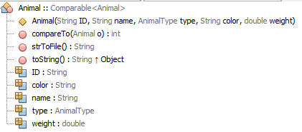
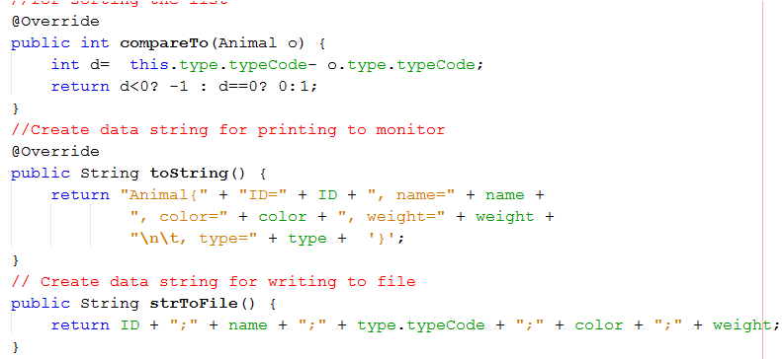
DDI: The Animal class
For sorting if needed
Create data string for writing to file
Create data string for printing to monitor

Slide 19

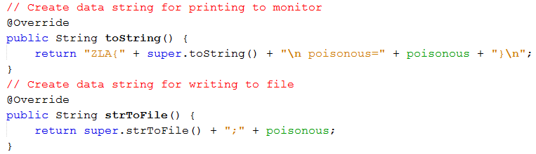
DDI: The ZLA::Animal class

Slide 20


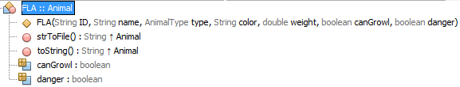
DDI: The BFLA, BFA, FLA classes
Methods toString(), strToFile() are implemented similarly to those in the ZLA class.

Slide 21
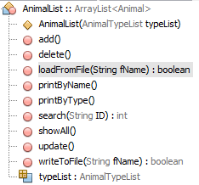
DDI: The AnimalList class
To initiate a animal list, the list of types must be available in advance.
For supporting search by name and by type
For checking whether new ID is duplicated or not

Slide 22
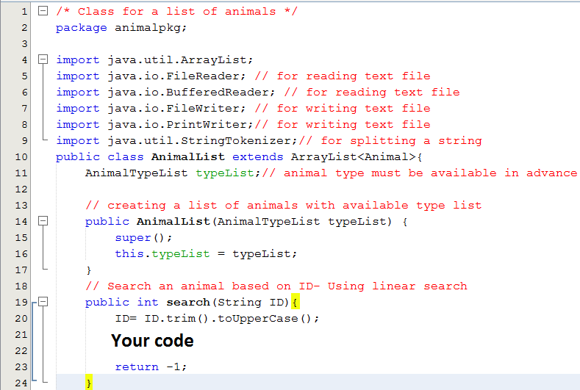
DDI: The AnimalList class

Slide 23
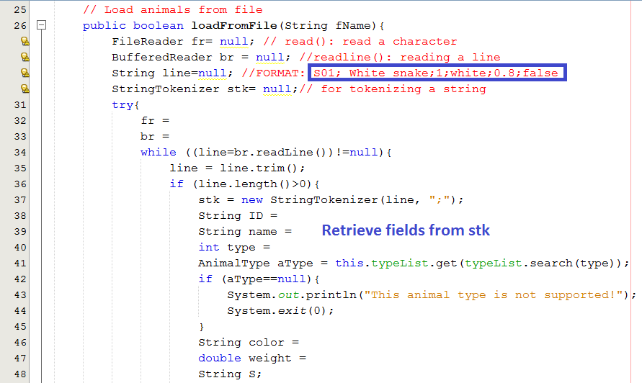
DDI: The AnimalList class

Slide 24
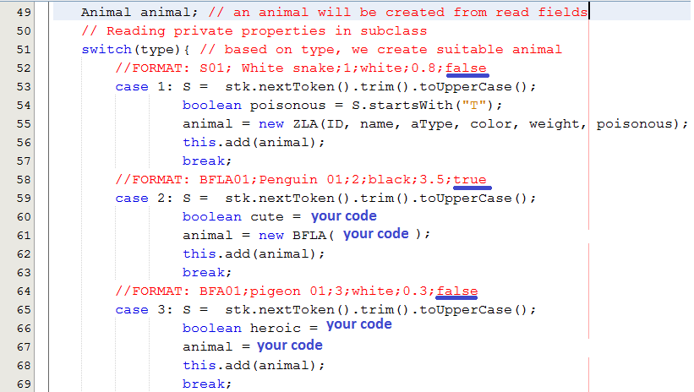
DDI: The AnimalList class

Slide 25
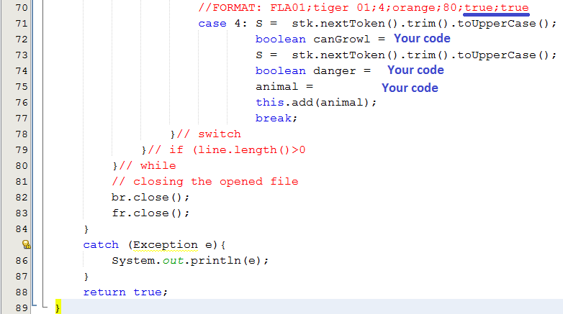
DDI: The AnimalList class

Slide 26
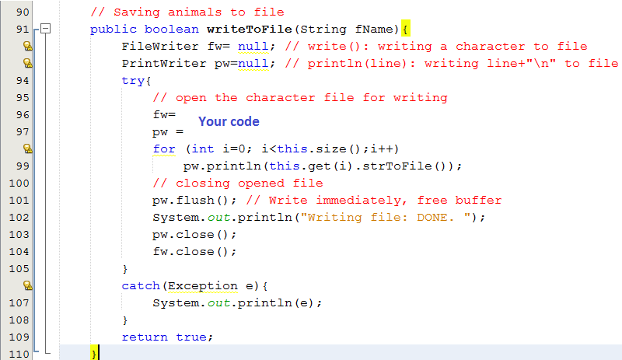
DDI: The AnimalList class

Slide 27
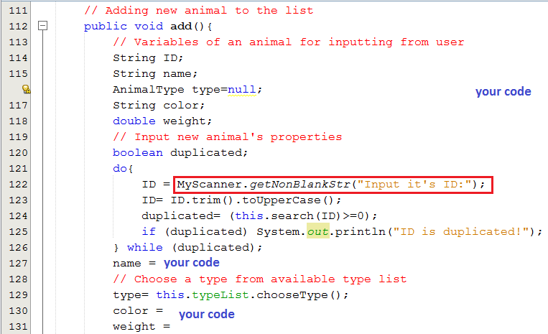
DDI: The AnimalList class

Slide 28
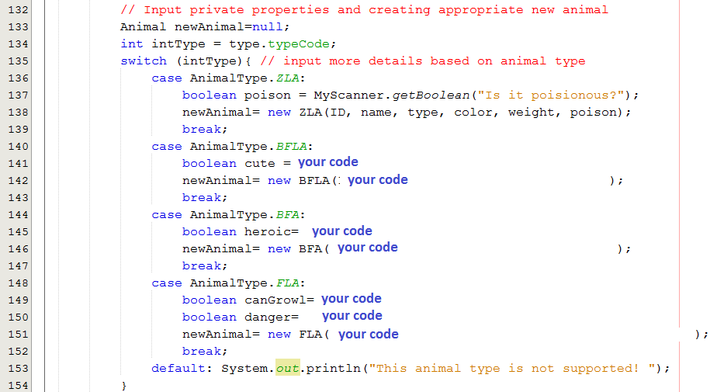
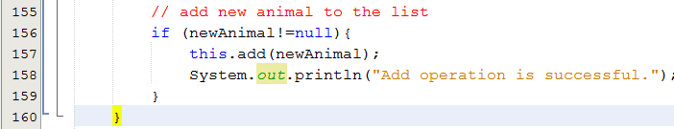
DDI: The AnimalList class

Slide 29
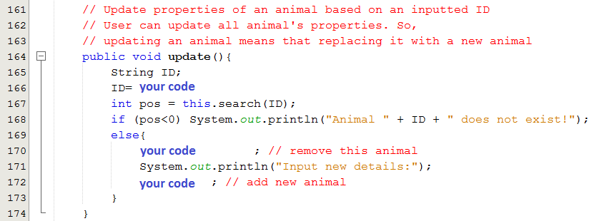
DDI: The AnimalList class

Slide 30
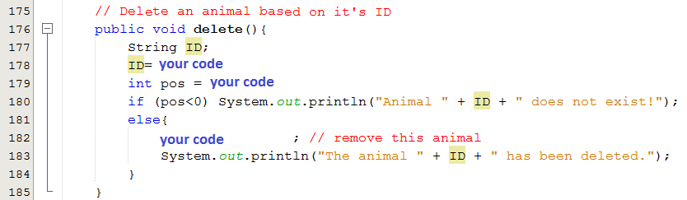
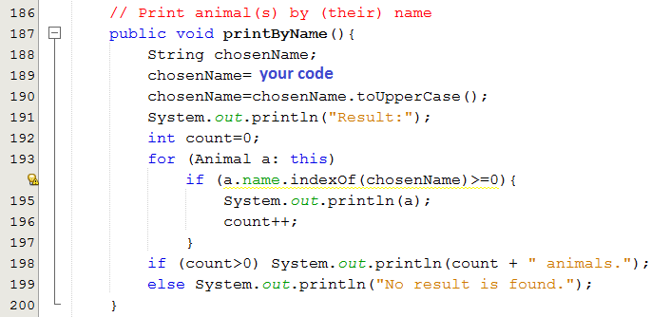
DDI: The AnimalList class

Slide 31
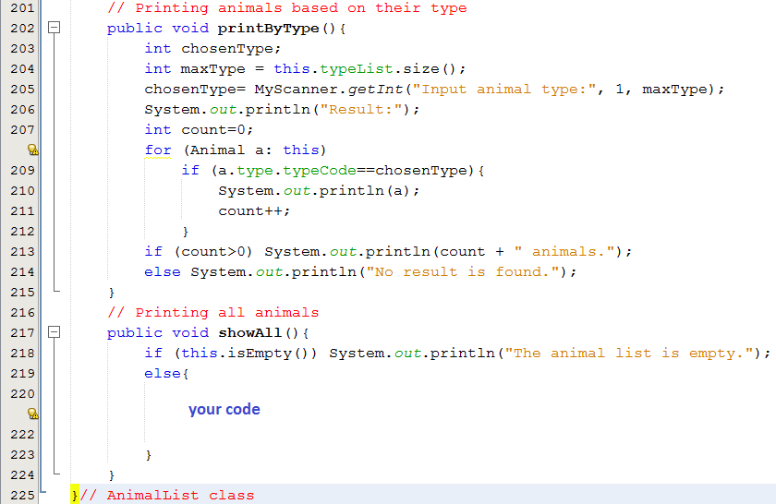
DDI: The AnimalList class

Slide 32

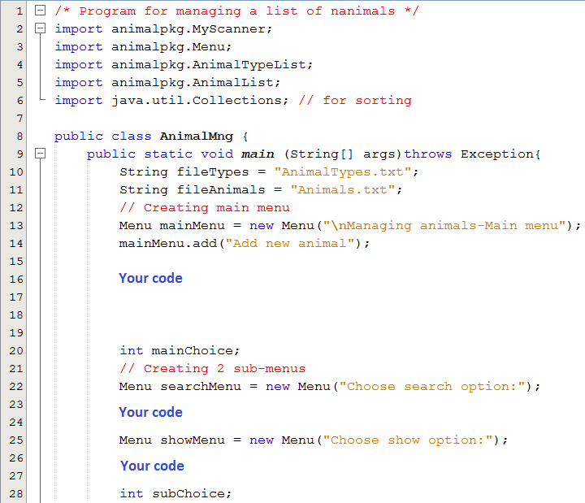
DDI: The AnimalMng class

Slide 33
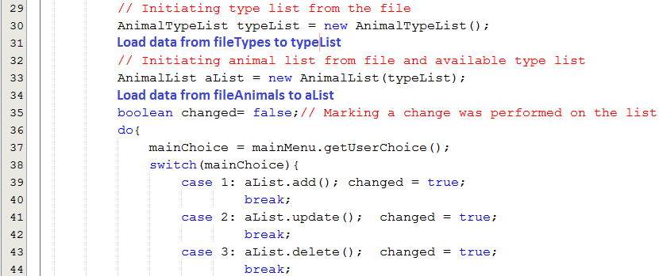
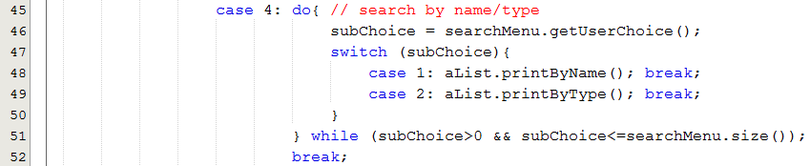
DDI: The AnimalMng class

Slide 34
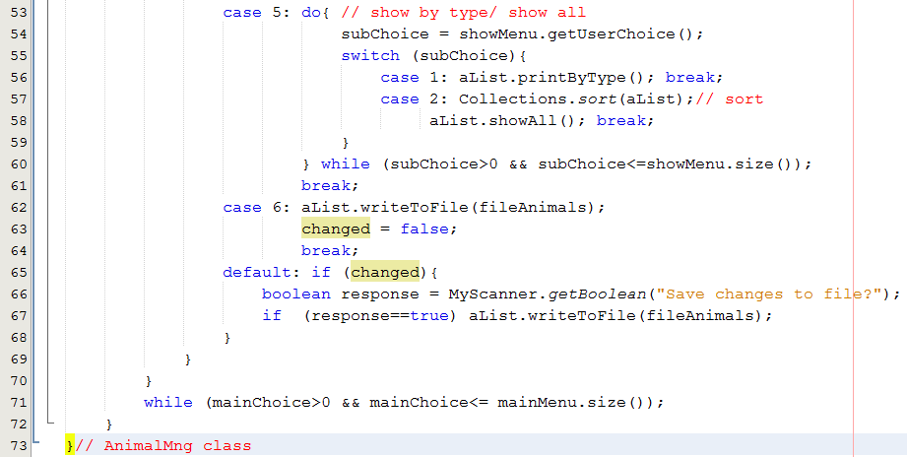
DDI: The AnimalMng class

Slide 35
END

